Slide 1
22C:19 Discrete Structures Sequence and Sums
Spring 2014
Sukumar Ghosh

Slide 2
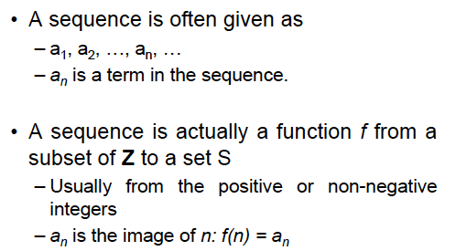
Sequence
A sequence is an ordered list of elements.

Slide 3
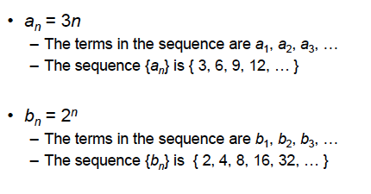
Examples of Sequence

Slide 4
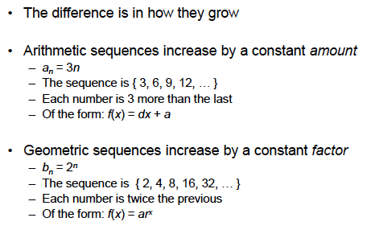
Examples of Sequence

Slide 5
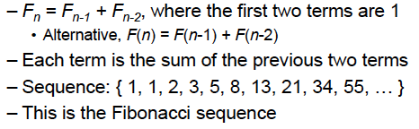
Examples of Sequence
Not all sequences are arithmetic or geometric sequences.
An example is Fibonacci sequence

Slide 6
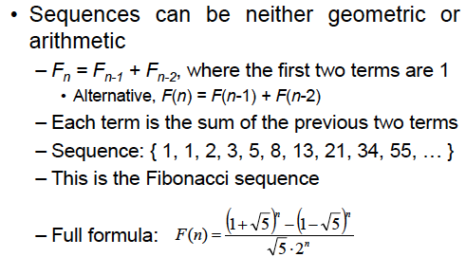
Examples of Sequence

Slide 7
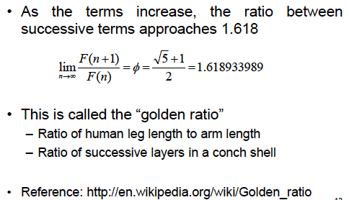
More on Fibonacci Sequence

Slide 8
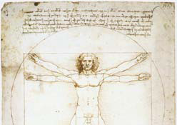

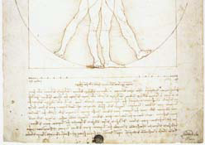
Examples of Golden Ratio

Slide 9
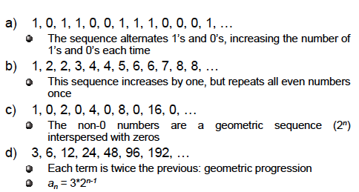
Sequence Formula

Slide 10
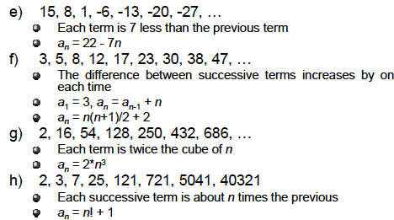
Sequence Formula

Slide 11
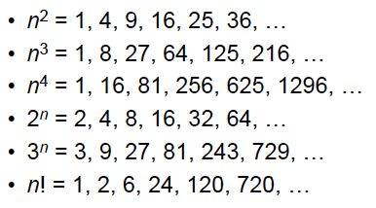
Some useful sequences

Slide 12
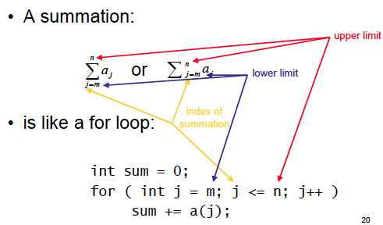
Summation

Slide 13
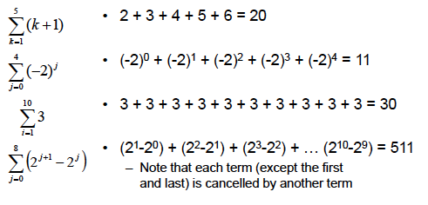
Evaluating sequences

Slide 14
Arithmetic Series
Consider an arithmetic series a₁, a₂, a₃, …, a_{n.} If the common
difference (a_{i+1} - a₁) = d, then we can compute the k^{th} term a_{k}
as follows:
a₂ = a₁ + d
a₃ = a₂ + d = a₁ +2 d
a₄ = a₃ + d = a₁ + 3d
a_{k} = a₁ + (k-1).d

Slide 15
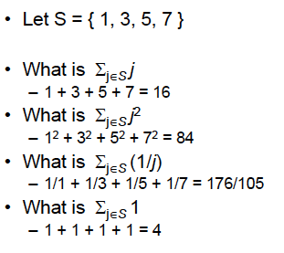
Evaluating sequences

Slide 16
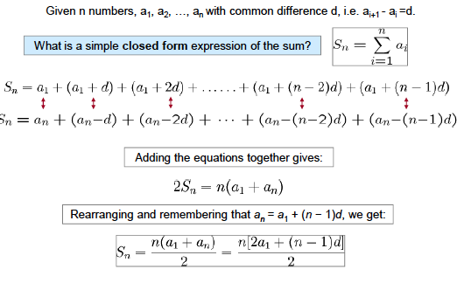
Sum of arithmetic series

Slide 17
Solve this
1 + 2 + 3 + … + n = ?
[Answer: n.(n+1) / 2] why?
Calculate 1² + 2² + 3²+ 4² + … + n²
[Answer n.(n+1).(2n+1) / 6]

Slide 18


Can you evaluate this?
Here is the trick. Note that
Does it help?

Slide 19
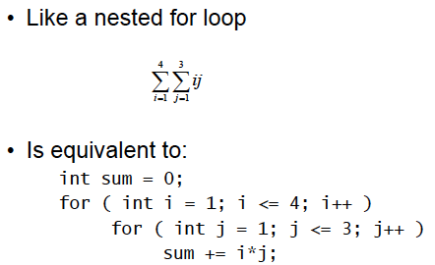
Double Summation

Slide 20
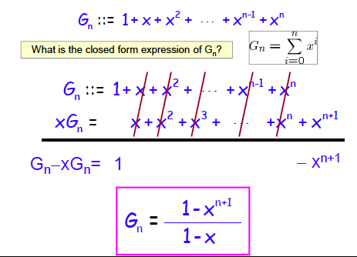
Sum of geometric series

Slide 21
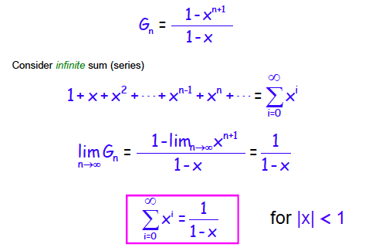
Sum of infinite geometric series

Slide 22
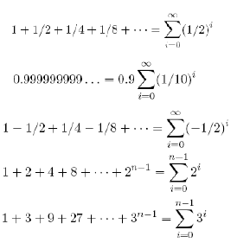
Solve the following

Slide 23
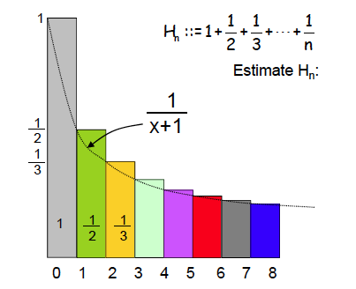
Sum of harmonic series

Slide 24
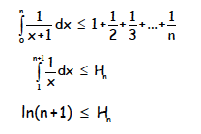
Sum of harmonic series

Slide 25
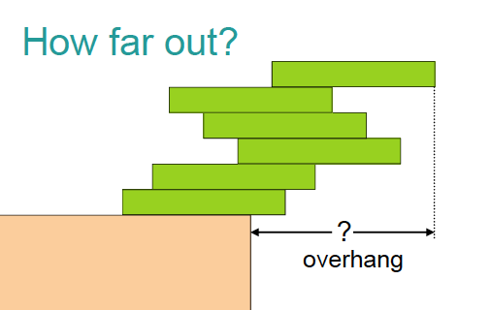
Book stacking example

Slide 26
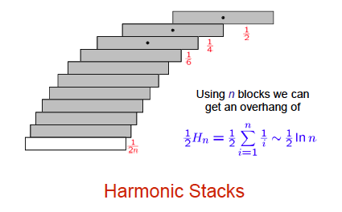
Book stacking example

Slide 27
Useful summation formulae
See page 157 of Rosen Volume 6
or
See page 166 of Rosen Volume 7

Slide 28
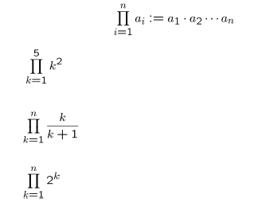
Products

Slide 29
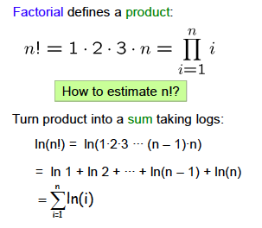
Dealing with Products

Slide 30
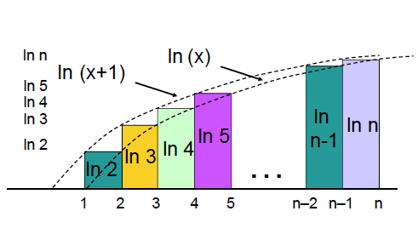
Factorial

Slide 31
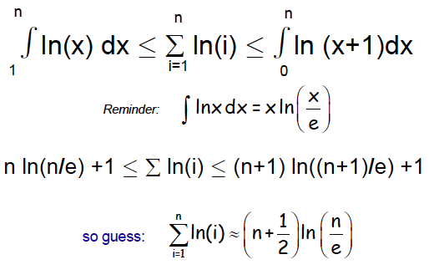
Factorial

Slide 32
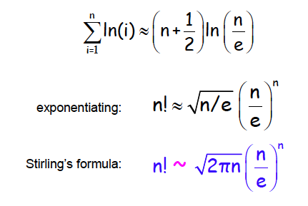
Stirling’s formula
Here ~ means that the ratio of the two sides approaches 1 as n approaches ∞
A few steps are omitted here

Slide 33
Countable sets
Cardinality measures the number of elements in a set.
DEF. Two sets A and B have the same cardinality, if and only if
there is a one-to-one correspondence from A to B.
Can we extend this to infinite sets?
DEF. A set that is either finite or has the same cardinality
as the set of positive integers is called a countable set.

Slide 34
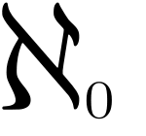
Countable sets
Example. Show that the set of odd positive integers is countable.
f(n) = 2n-1 (n=1 means f(n) = 1, n=2 means f(n) = 3 and so on)
Thus f : Z⁺ → {the set of of odd positive integers}.
So it is a countable set.
The cardinality of an infinite countable set is denoted by
(called aleph null)

Slide 35
Countable sets
Theorem. The set of rational numbers is countable.
Why? (See page 173 of the textbook)
Theorem. The set of real numbers is not countable.
Why? (See page 173-174 of the textbook).

